Slide 1
RCL.PL.THM1
RVM Requirement Number | THM1
RVM Requirement Wording | All CubeSat components shall be rated to withstand a temperature range of at least -20 ⁰C to 70 ⁰C
Validation Method | Analysis
For those components that are developed at the SSRL, each component that is used in its assembly will be rated to operate within said range.

Slide 2
RCL.PL.PRP2
RVM Requirement Number | PRP2
RVM Requirement Wording | Static Thrust testing will be performed with the flight pressure vessel prior to CubeSat integration at a pressure no greater than 1x10^-4 Torr
Validation Method | Test
The propulsion system must pass the static test fire with no anomalies to meet this requirement.

Slide 3
RCL.PL.PRP3
RVM Requirement Number | PRP3
RVM Requirement Wording | The pressure vessel must pass thermal cycle testing between temperatures of -30 ⁰C and 70 ⁰C for a total of two cycles or 10 hours
Validation Method | Test
The propulsion system shall perform static thrusts before the thermal cycle, during the cycle at various points, and finally, after the thermal cycle.
Figure 1-1. Rascal Thermal Cycle Test Profile

Slide 4
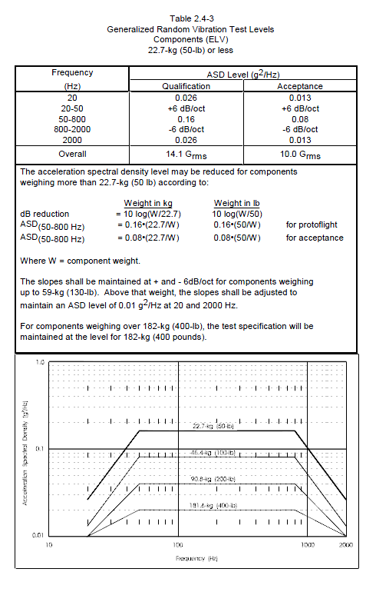
RCL.PL.TST1
RVM Requirement Number | TST1
RVM Requirement Wording | CubeSat must survive Random Vibration Testing relative to the NASA GEVS Qualification Profile
Validation Method | Test
Using the GEVS profile covers as many vibration environments as possible.
Figure 1-3. NASA GEVS Random Vibration Profile

Slide 5
RCL.PL.TST2
RVM Requirement Number | TST2
RVM Requirement Wording | CubeSat shall be subjected to a temperature of 60 ⁰C at a pressure of 1x10^-4 Torr for at least 6 hours
Validation Method | Test
This is called a bakeout and its purpose is to remove volatile material from the CubeSat system so it does not damage nearby spacecraft.

Slide 6
RCL.PL.TST3
RVM Requirement Number | TST3
RVM Requirement Wording | Full CubeSat System shall be able to execute all commands associated with its operation over RF
Validation Method | Test
The requirement needs to be met so the CubeSat system can perform functional tests.

Slide 7
RCL.PL.TST4
RVM Requirement Number | TST4
RVM Requirement Wording | Full CubeSat System shall be able to close a link with the SSRL Ground Station from a distance of at least 200 meters
Validation Method | Test
It has been required by the Air Force Research Laboratory before testing can take place there, thus leading to its requirement for the Rascal mission. It also improves confidence in the reliability of the Rascal communication system prior to launch.

Slide 8
RCL.PL.TST5
RVM Requirement Number | TST5
RVM Requirement Wording | Full CubeSat System shall be able to document the functionality of each subsystem through the running of a full-functional test
Validation Method | Test
To meet this requirement each subsystem in the CubeSat system must successfully execute any on-orbit command that could potentially be sent to it, as well as demonstrate key on-orbit operations.

